Slide 1
Metal surface defects detection
Μηχανική μάθηση σε πολυμεσικά δεδομένα
ΣΙΔΗΡΟΠΟΥΛΟΣ ΜΙΧΑΛΗΣ 2320
ΠΑΠΑΔΟΠΟΥΛΟΣ ΔΗΜΗΤΡΗΣ ΙΑΣΟΝΑΣ 2315

Slide 2
Agenda
Introduction
Data
Model Training
Model Testing - Evaluation
Conclusion

Slide 3
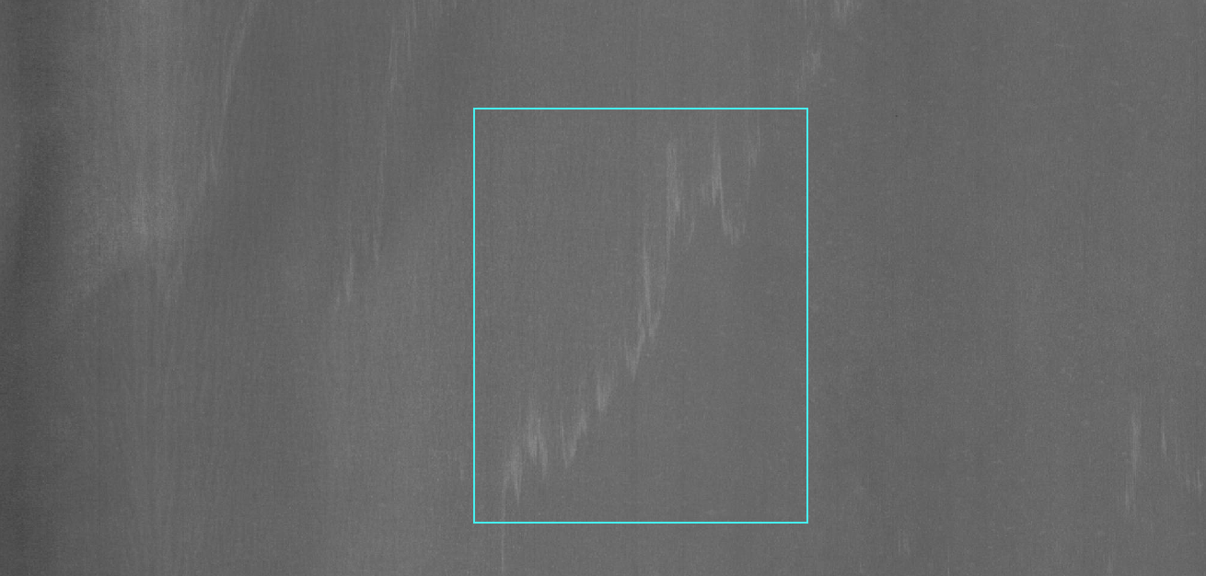
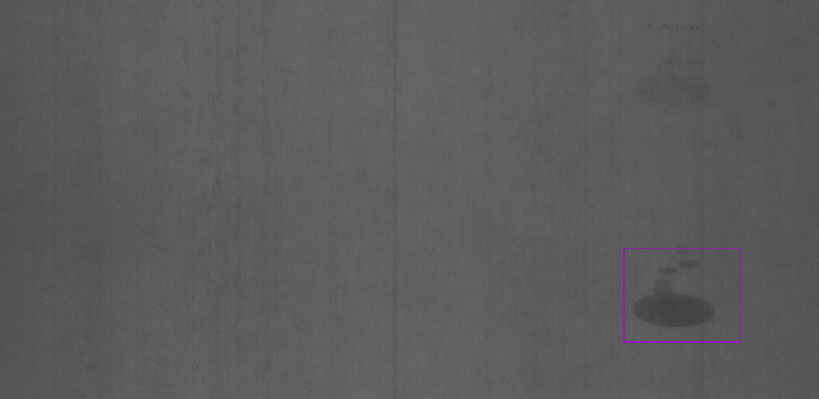
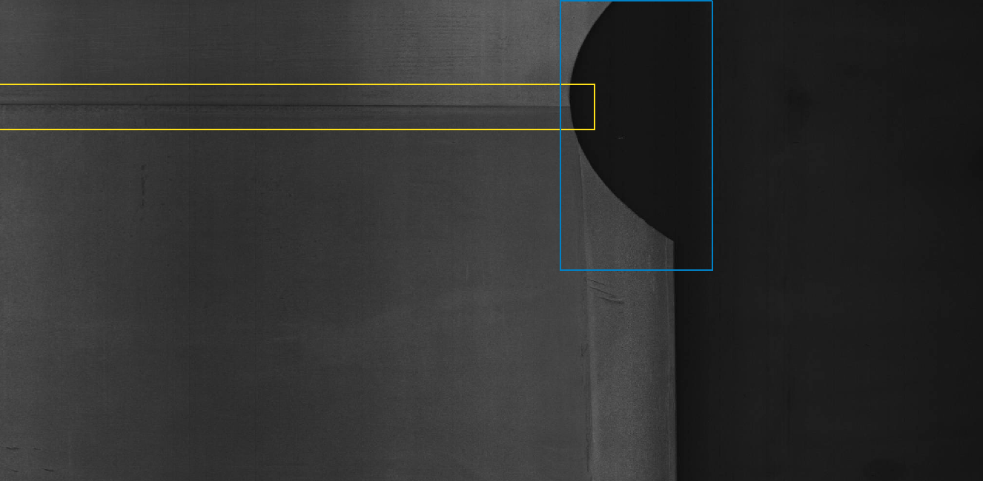
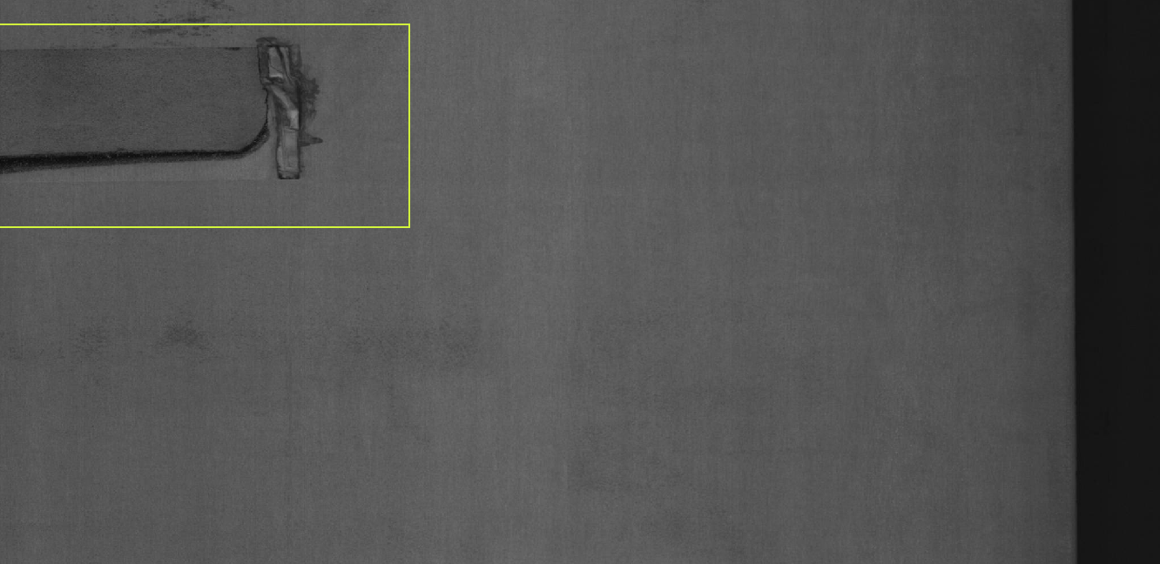
DATA
Silk spot:
Oil spot:
Welding line:
Crescent gap:
Rolled pit:

Slide 4
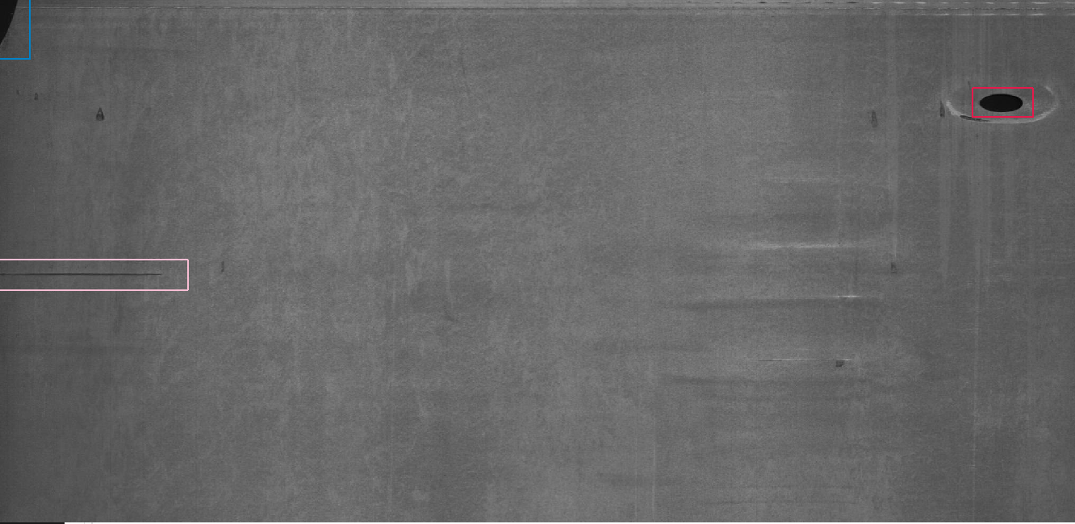
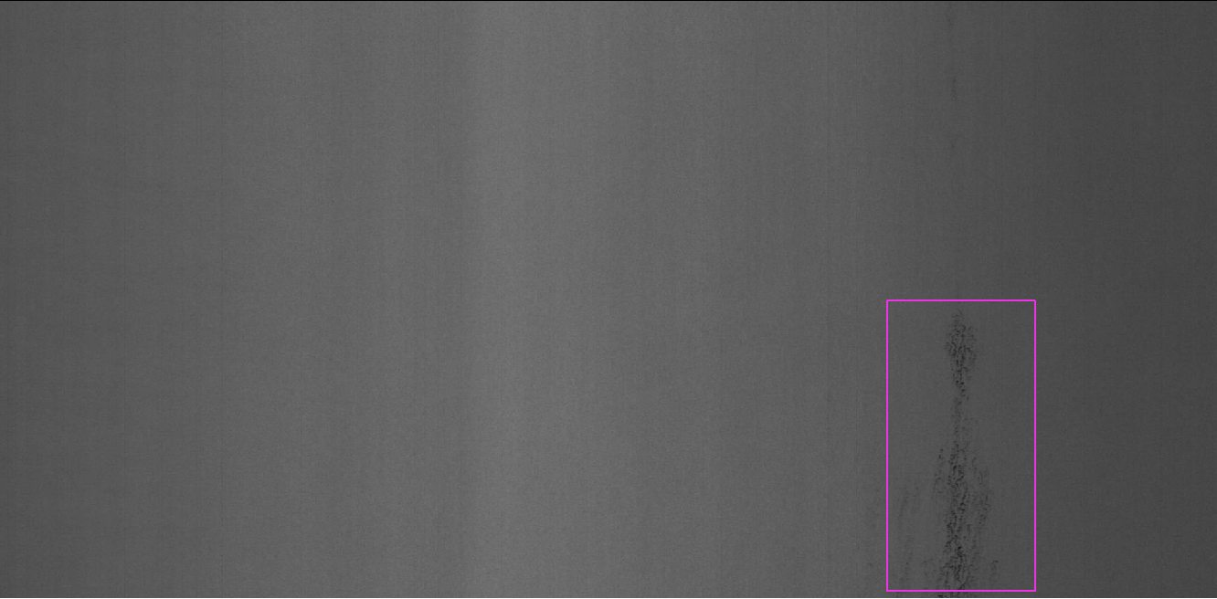
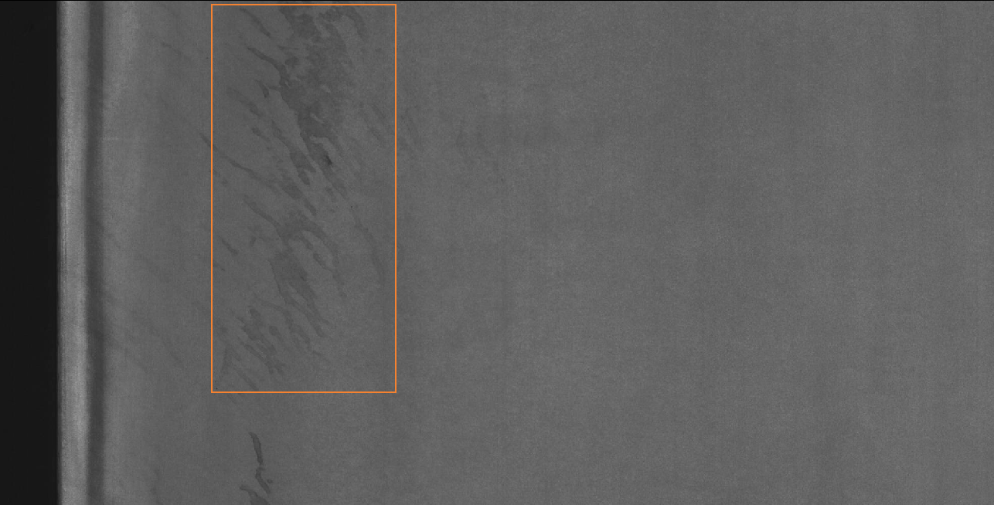
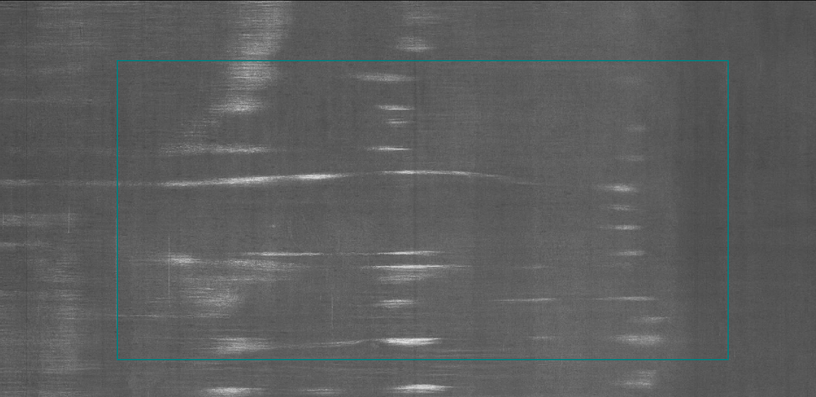
DATA
Punching hole:
Crease:
Inclusion:
Water spot
Waist folding:

Slide 5
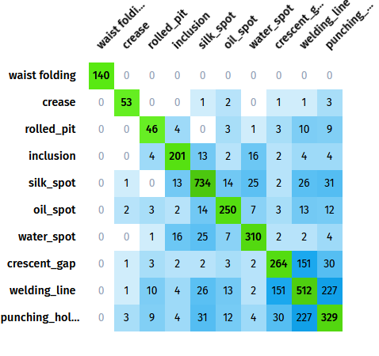
DATA
Total Images: 2300
Total Annotations: 3563
Image size: 2048x1000

Slide 6
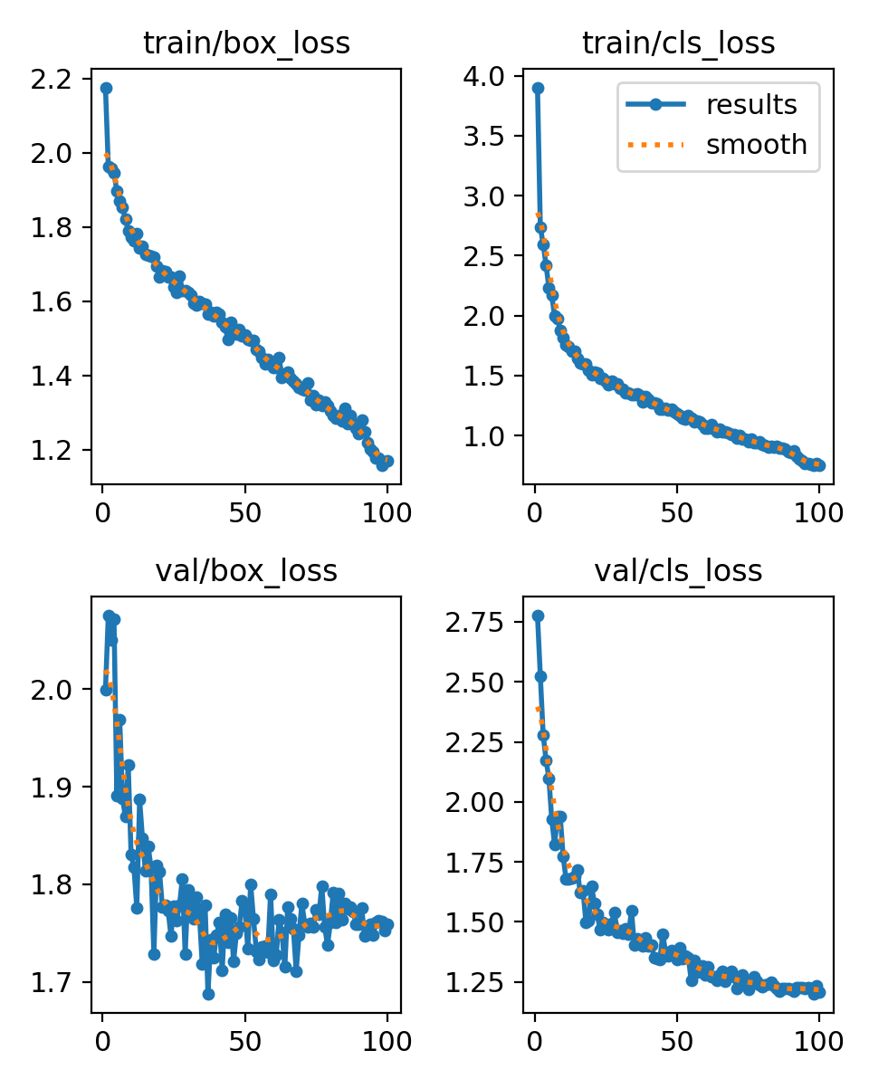
YOLO TRAINING
100 epochs
Batch size 16
Input size: 640x640
Bounding Box Loss
Classification Loss

Slide 7
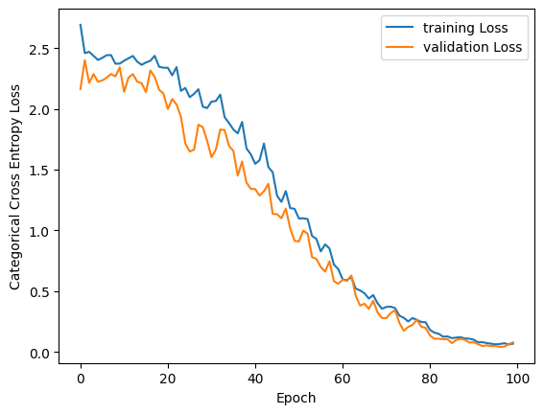
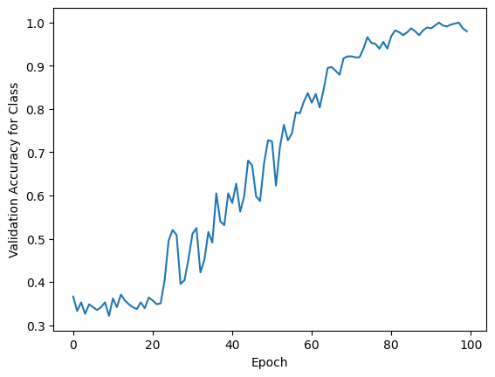
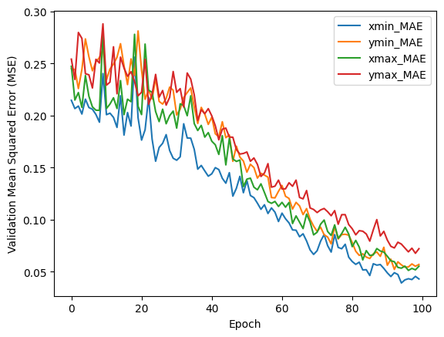
VGG-16 TRAINING
100 epochs
Input size 224x224
Batch size 32

Slide 8
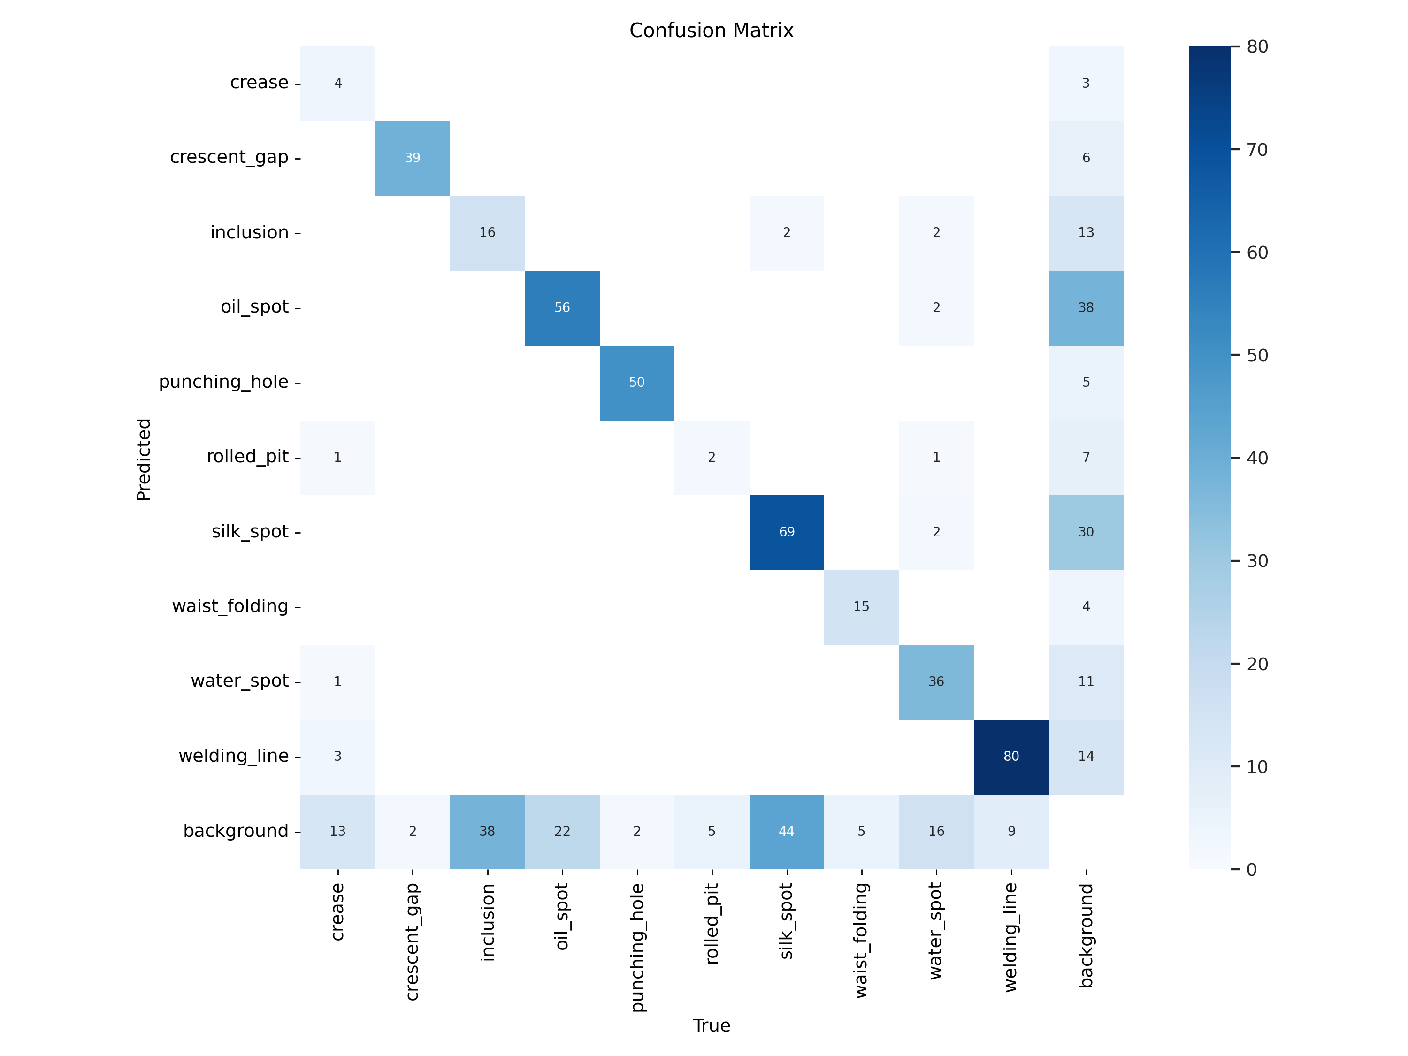
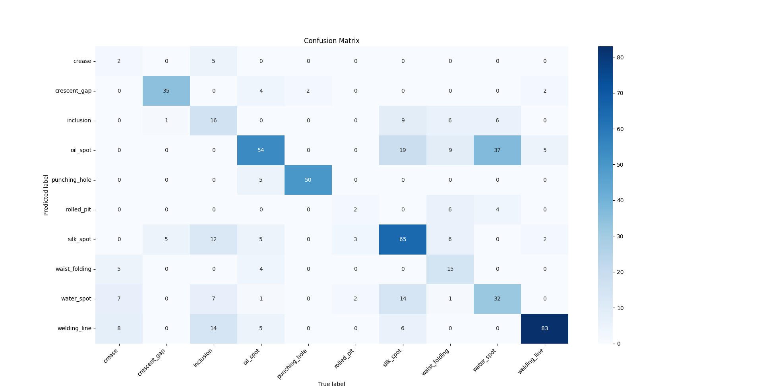
TESTING
YOLO Evaluation
VGG-16 Evaluation

Slide 9
Conclusions
Imbalanced Dataset – Reduced Performance
Both Models Performed adequate
Need of better Datasets
Organization
Annotation

Slide 10

THANK YOU

